Slide 1
X-Terminate
TEAM

Slide 2


Slide 3
Build Your Career

Slide 4


Slide 5
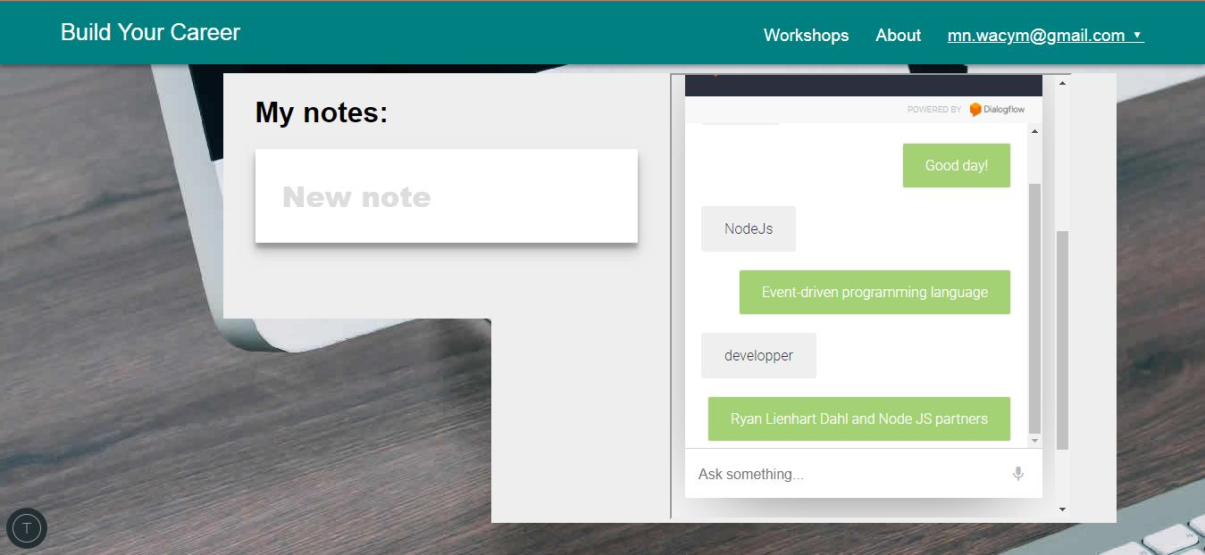

Slide 6


Slide 7


